Slide 1
Blurring Lines Between Donations, Season Tickets, Required Seat Donations (RSD) & Memberships

Slide 2
MODERATORS
Elsie Kuresa, Paciolan
PRESENTERS
Ashlee Shidler, Texas A&M (Ticket Office, 12th Man Foundation)
Justin Zenz, James Madison University
Grant Duncan, Virginia Tech

Slide 3
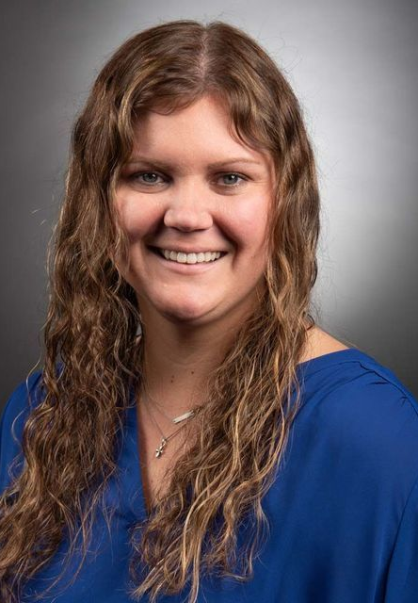
Ashlee Shidler
Texas A&M

Slide 4


Our Renewal Program…
Almost 10,000 paid season ticket holders
Year 7 with current process & 100% digital for a few years now
4 Types of Renewals: Suites, Endowed, Regular, New Season Ticket Holders
Tickets & Donations are renewed at same time
  Includes opportunity to buy & donate more
Renewal Working Group (Representation from ALL departments)
Our teams:
  Donor Service Center (6)
    Handles approximately 2,000 calls
    Questions, help renewing online, proactive calls
  Sales Team (4-6)
    Handles all high-risk accounts
Notes:
We have between 9 – 10 K paid season ticket holders
We have had a per seat donation program in place starting in the early 1990s but our current version of per seat donation dates back to the redevelopment of Kyle Field in 2015.
Only send paper to fans who all and request one
YOY renewal rate is in the low 90s
2022 is going to be a regular season, but we’re coming off a good recruiting cycle – sitting at #1

Slide 5
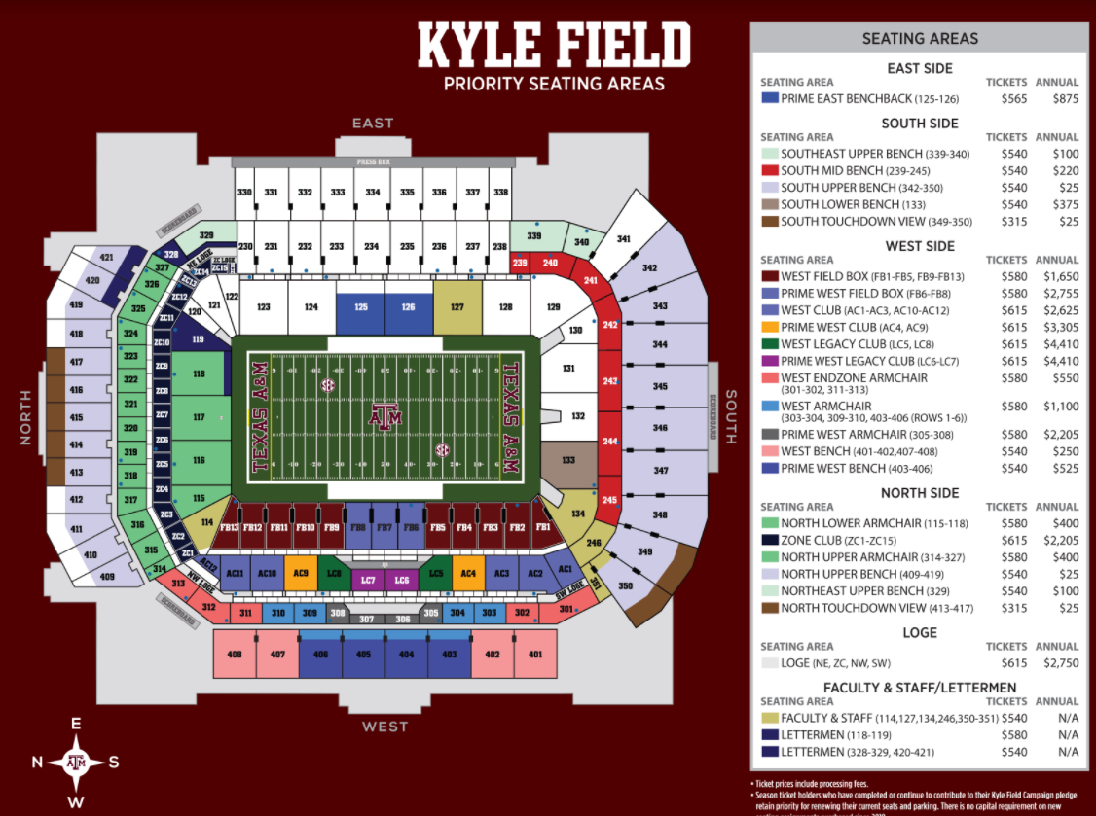
Every Seat Has a Required Seat Donation
Notes:
Every seat that is sold on a season basis has a required seat contribution associated with it. Our donation model is pretty complex, as you can see there are lots of different price levels and areas. There is a little variation in ticket pricing depending on what type of seat you have – bench, benchback, armchair, club/suite - but donations vary a lot more.

Slide 6
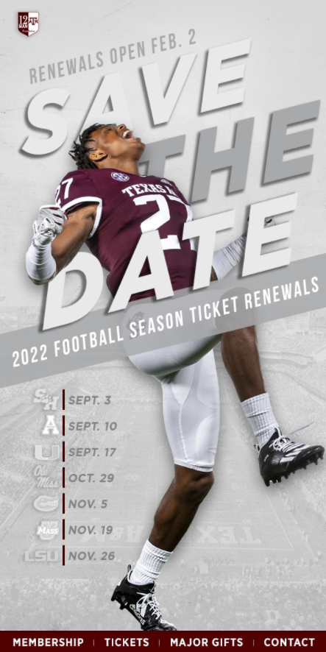
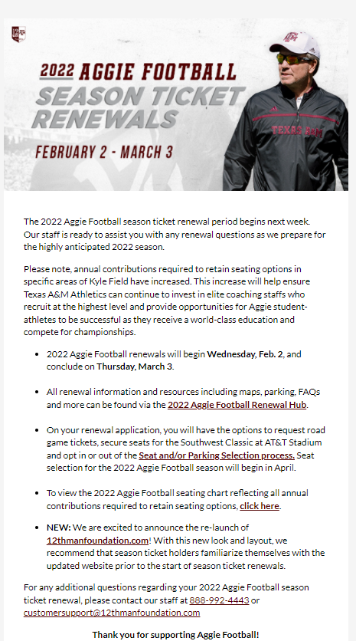
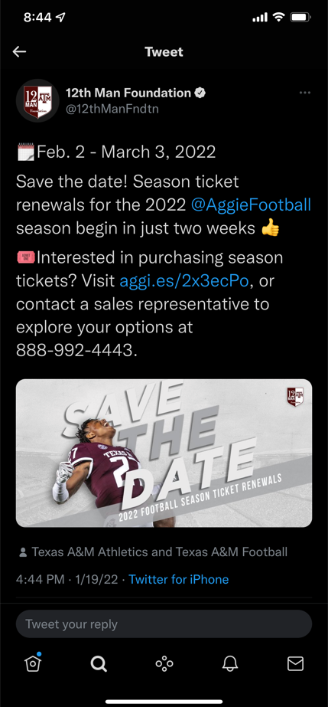
Our Renewal Cycle…Pre-Launch Campaigns
Executed 2 weeks before renewal launch
Notes:
Speak to how early you send out your pre-launch campaigns
Save the dates email and social push – open rates
Speak to how you include the Football Renewal HUB in the pre-launch so fans can get all their info early and be prepared prior to renewals starting

Slide 7
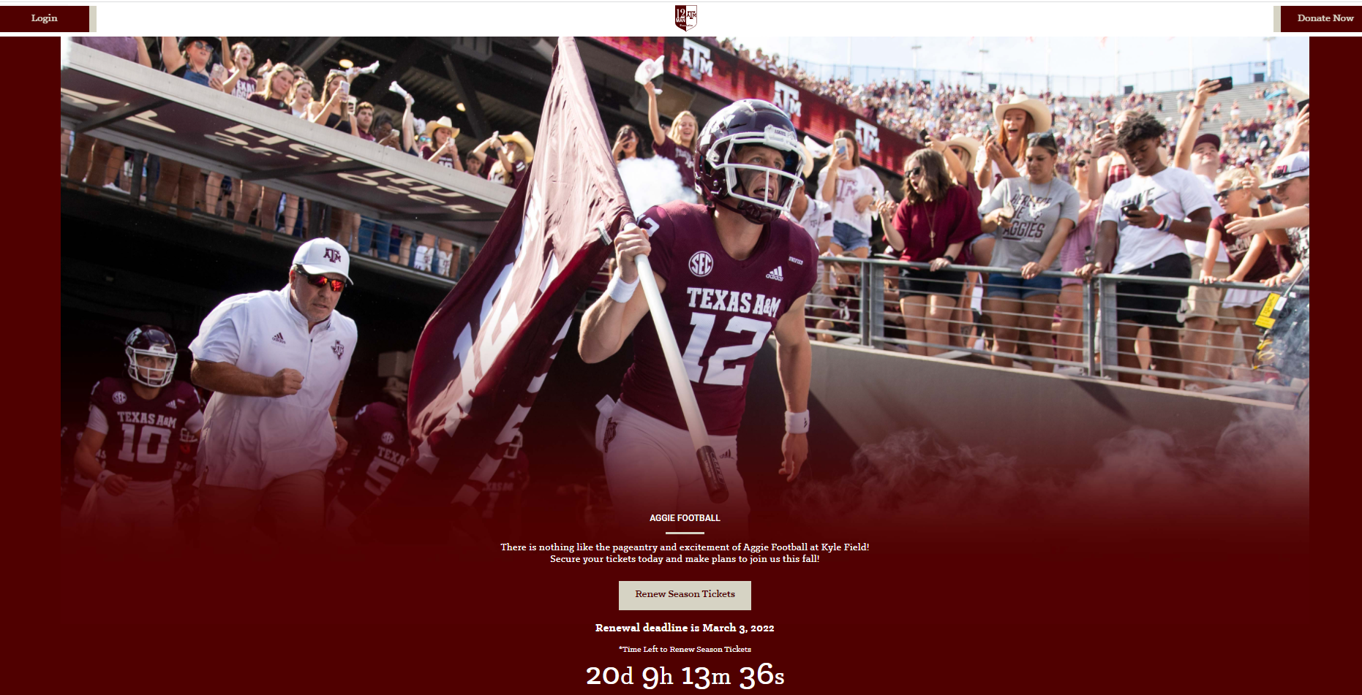
Pre-Launch with access to Football Renewal HUB
Notes:
Hub is released about a week in advance of renewals and is referenced in our "renewal information" email that is sent. It allows STH to review information that is associated with renewals and hopefully will help to answer any questions they may have. We have a countdown on the main page up until renewals and then the button will link STH directly where they can log in and complete their application.

Slide 8
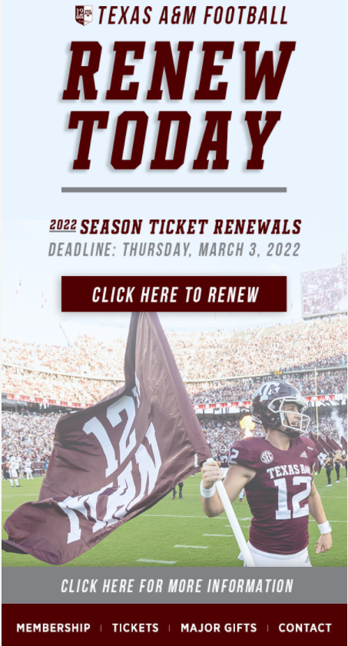
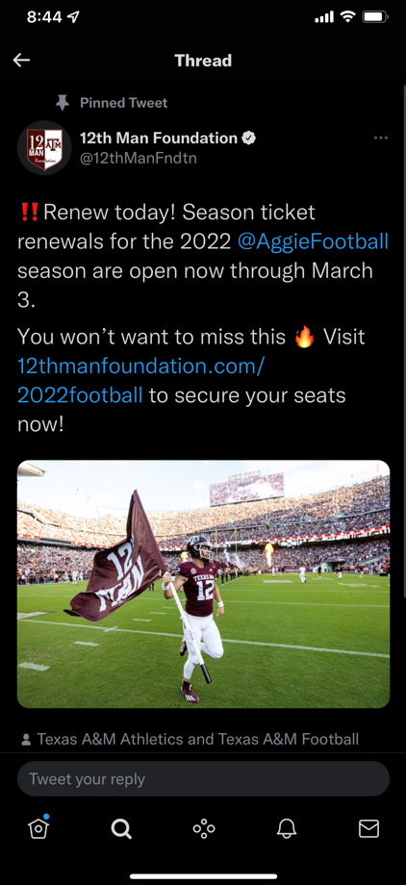
Launch Campaign
Notes:
We send a renewals open email along with a social push – open rates

Slide 9
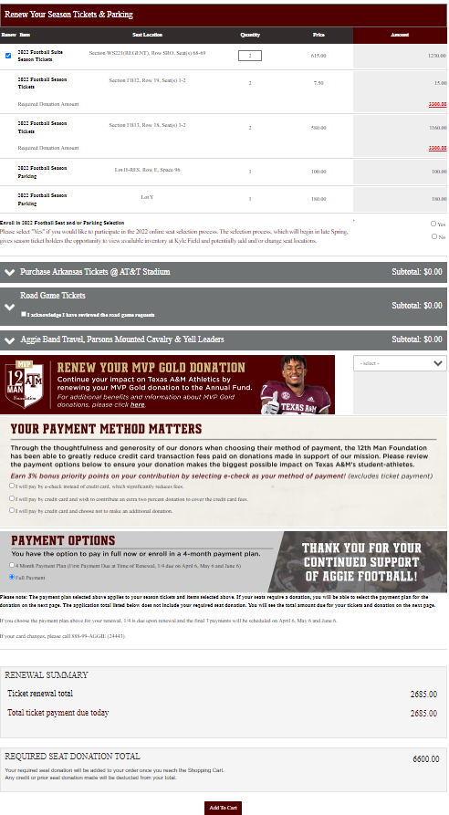
Our Online Renewal Form
Top ½
Renewable Seats & Seat Donations
Bottom ½
Additional items, tickets, donations, & Payment Options
Notes:
Our renewal is split into 2 different parts – the top half is renewable seats/parking and any required seat donations. We also have a seat selection opt in our out opportunity which is a required field to add the renewal to the cart. The STH must click yes or no on if they want to participate in the ballena process.
The bottom half is where we have our neutral site game with arkansas, road games, additional giving opportunities to specific groups associated with football at our school, annual fund giving and payment options. The Your Payment method matters section is where we encourage STH to pay with echecks and give the opportunity for those paying with credit card to donate a percentage of their total to help cover credit card fees we will be charged. They can also pay with a cc and not pay the donation but we put that in front of our ticket holders and get a lot of echecks and cc fee donations.

Slide 10
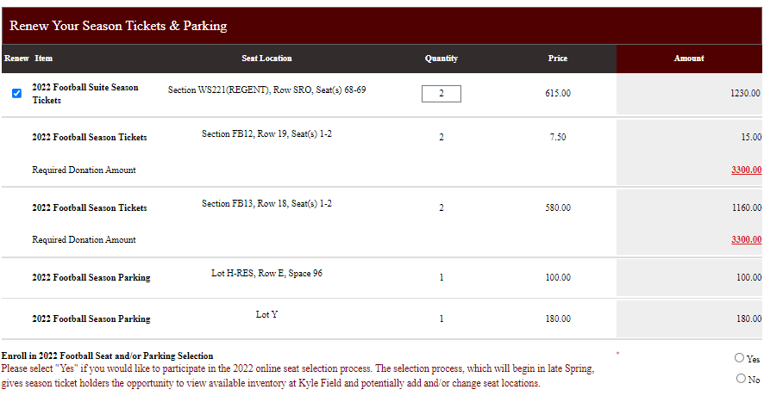
Our Online Renewal Form
Top ½ - Renewable Seats & Seat Donations

Slide 11
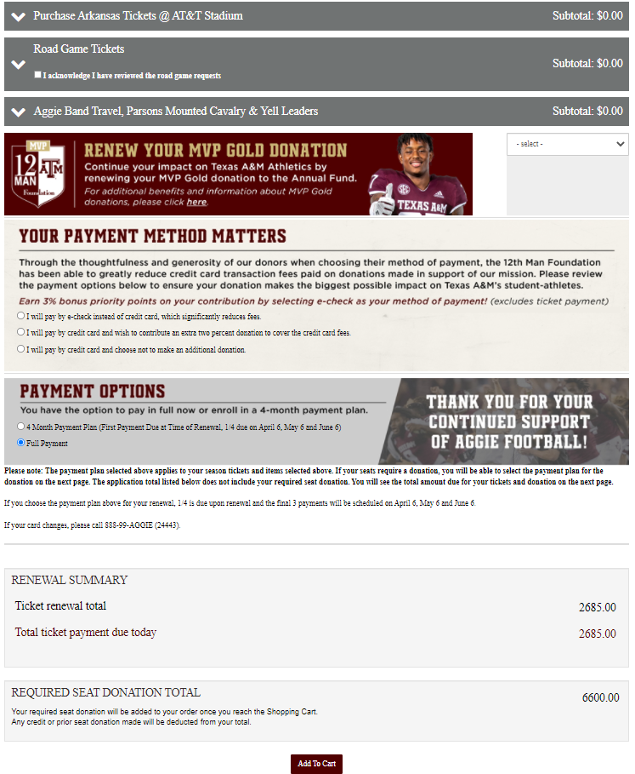
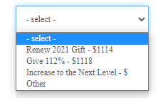
Our Online Renewal Form
Bottom ½ - Additional items, tickets, donations, & Payment Options
Football 2022: $252K (in progress)
Football 2021: $313K
Football 2020: $339K
Football 2019: $232K

Slide 12
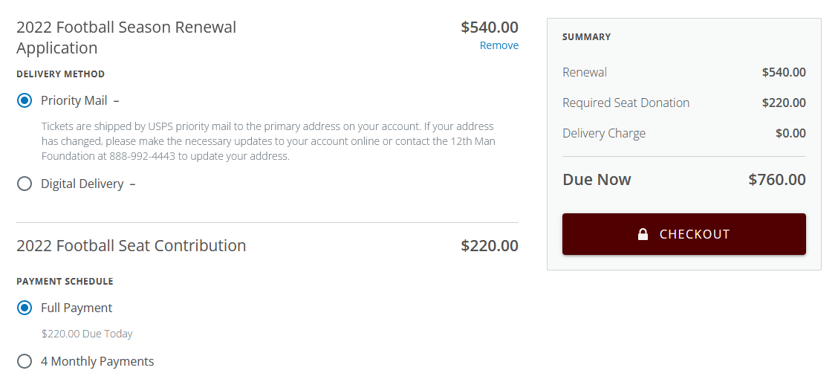
Payment Process – 1 Payment for Seats &
Required Donations

Slide 13
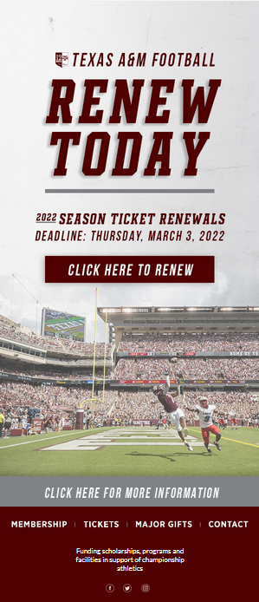
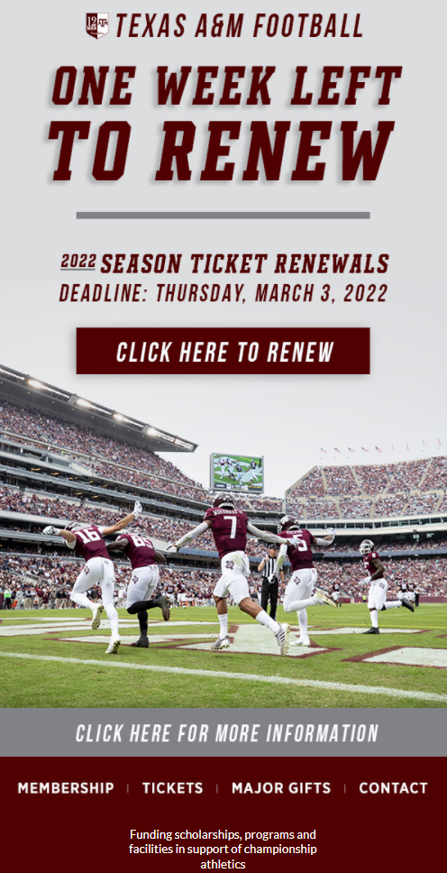
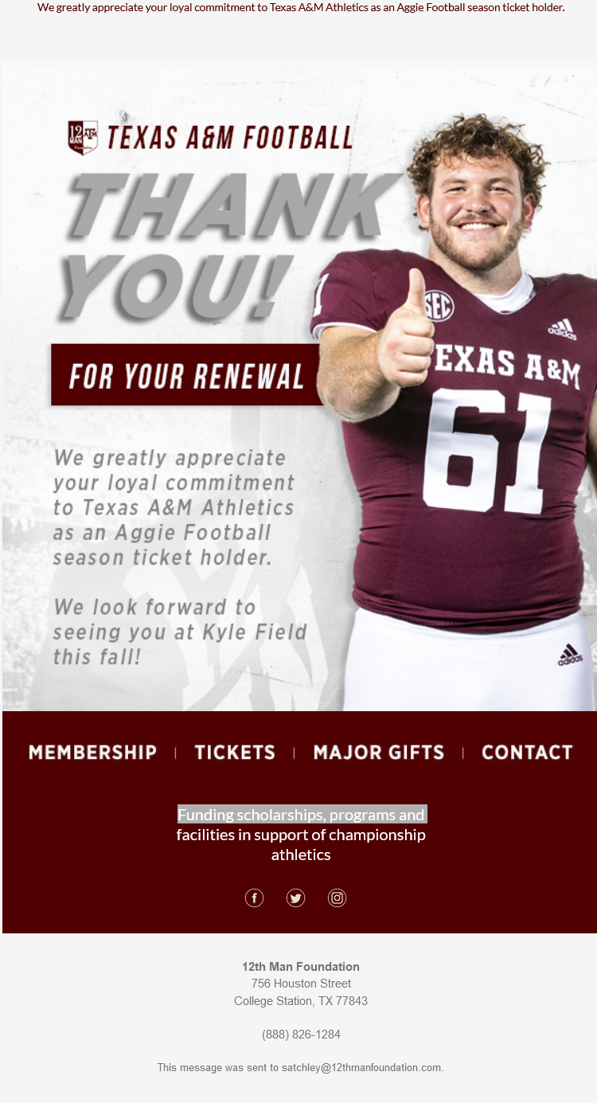
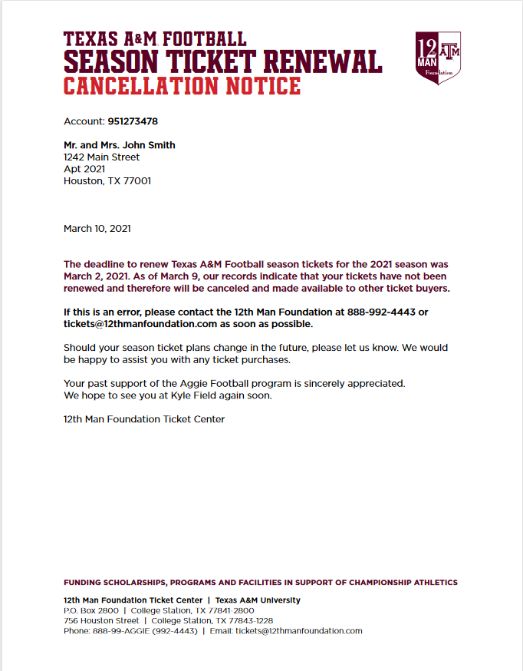
Ongoing and Post Renewal Campaigns
Notes:
We are doing something new (for us) this year and running a thank you campaign after accounts complete their applications online.
DETAILS....

Slide 14
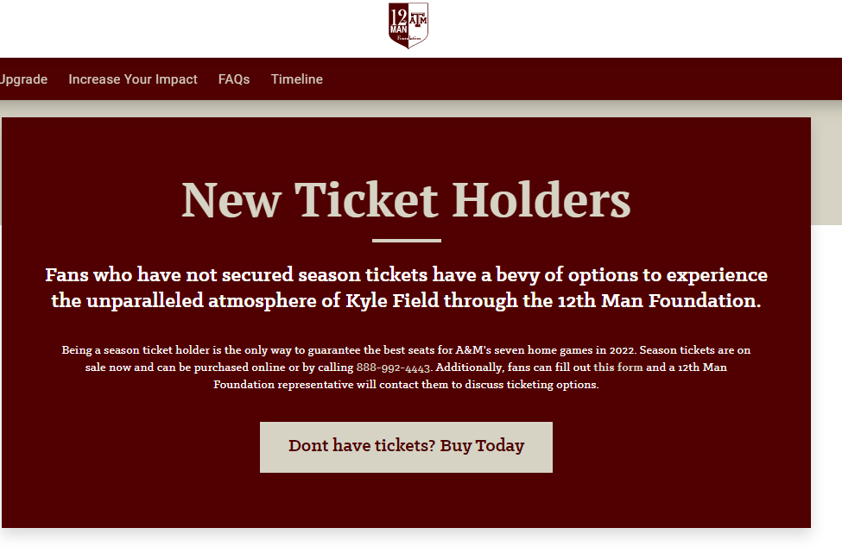
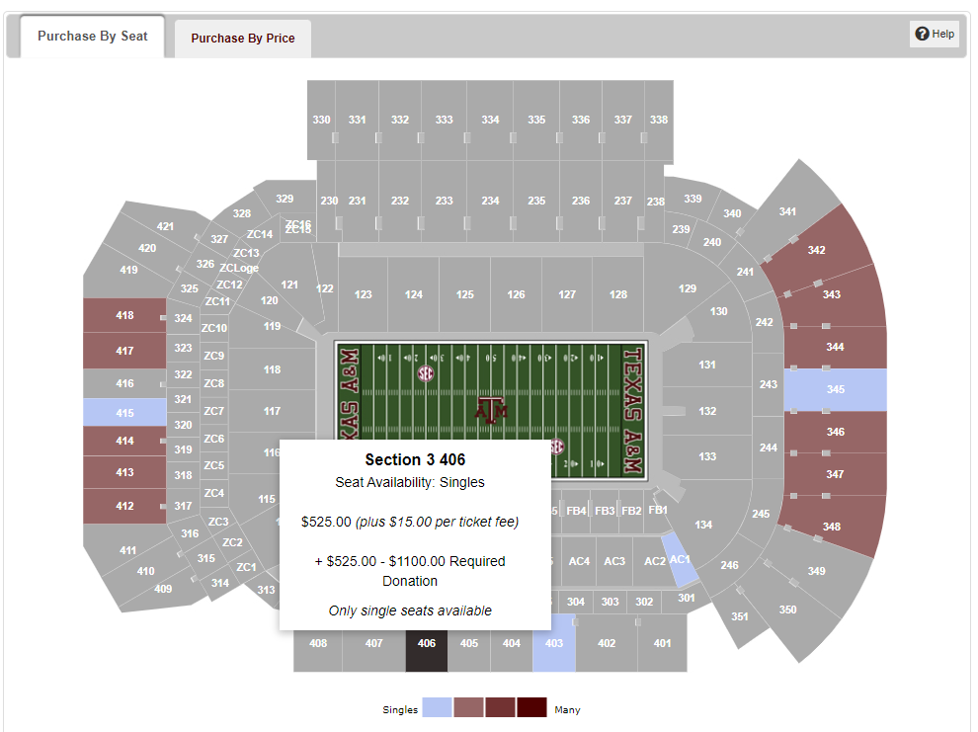
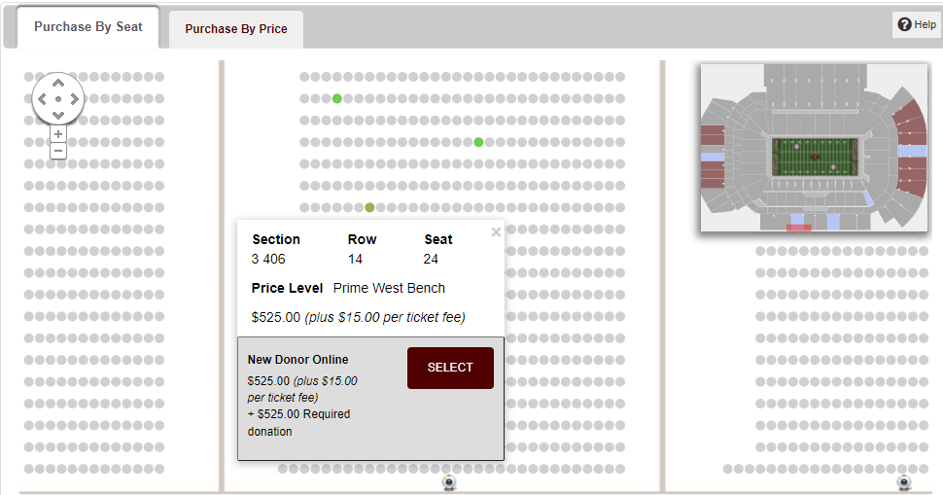
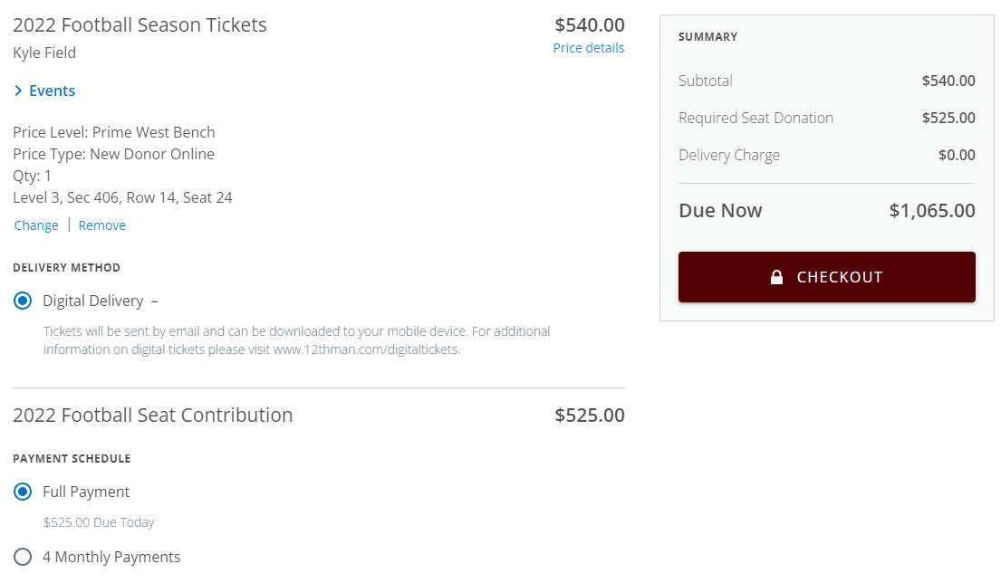
New Season Ticket Sales
Sold Football 2022 Season Tickets during 2021 season
  Over 500 new season tickets sold in-season prior to Dec 2021
  $275K in new season ticket revenue & $418K in donation revenue
RSD captures ticket $ and donation $ in 1 payment

Slide 15
Key Take-Aways
“Renewal Planning Group” – a must have!
Early, Ongoing, & Post Fan Communication is Key
Take advantage of additional giving opportunities
Push to sell season tickets early and in-season if possible

Slide 16
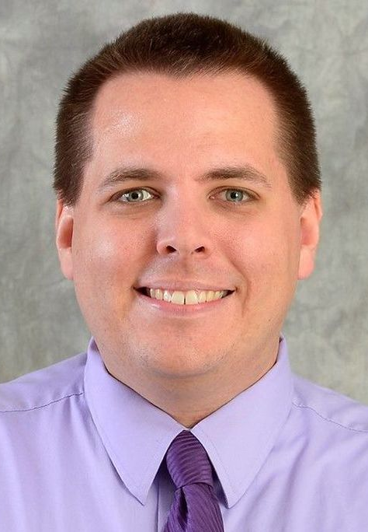
Justin Zenz
James Madison University

Slide 17

Our Program…
Synergy & Collaboration between Ticket Office & Duke Club
  Duke Club staff member within the Ticket Office
  All renewal related calls come into the Ticket Office
All donations MUST be processed through the Duke Club Merchant ID
Exciting change this year – moving to the Sun Belt Conference!
2,000 paid season ticket holders
2019 implemented our per seat contribution model; was strictly membership based for seats & parking previously
  Why the change? Tax and Jobs Cut Act of 2017
  Parking is still membership based
In our 2nd year including per seat contribution in season ticket renewal with RSD
  Simple online renewal & purchase process for the fan – 1 stop shop!
  Flexibility of setting up payment plans for each separately is great
  Box Office order processing is efficient & easy
New Season Ticket Sales

Slide 18
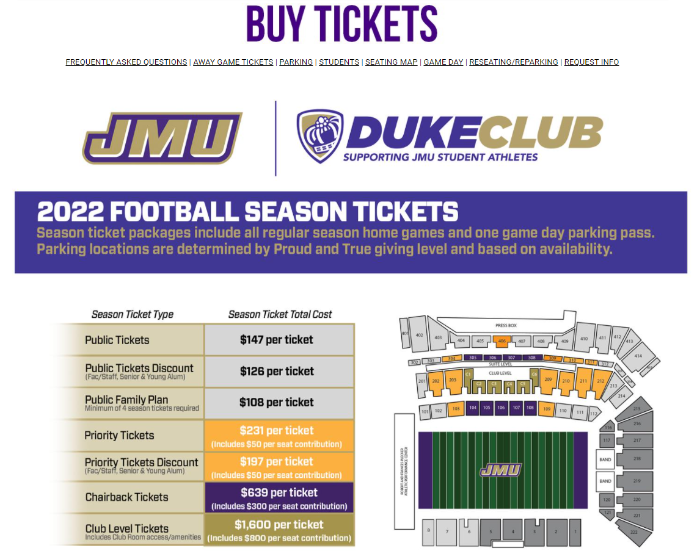
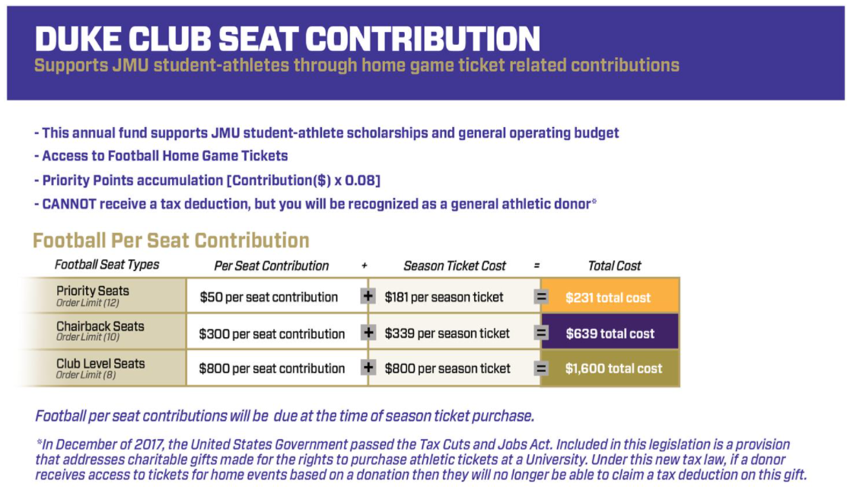
Our Season Ticket & Per Seat Donation Model

Slide 19
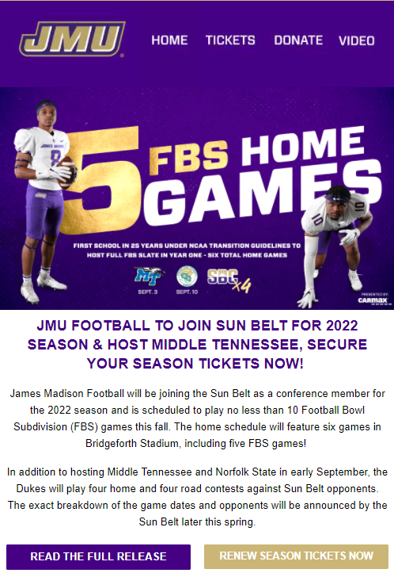
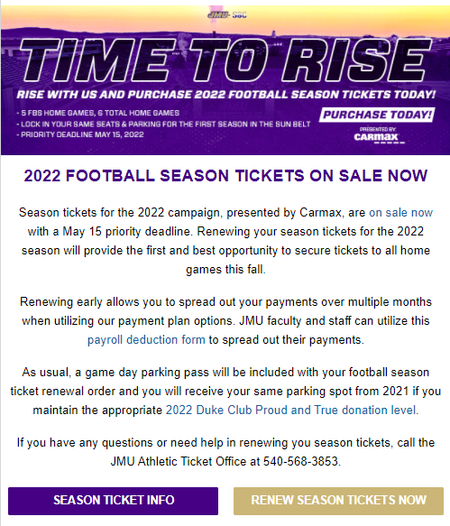
Renewal Launch Campaign – launched on Feb 2nd

Slide 20
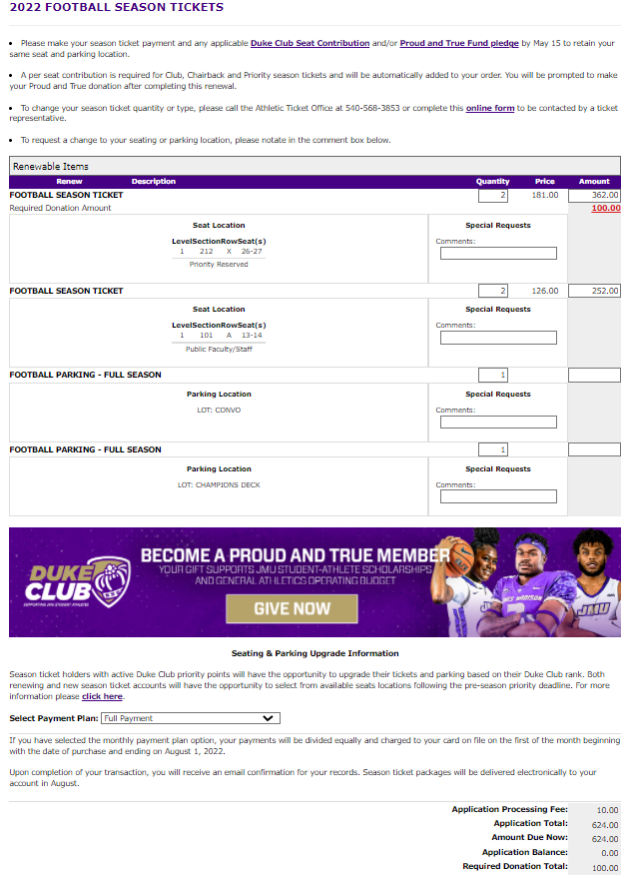
Our Online Renewal Form
Top ½
Renewable Seats & Seat Donations
Bottom ½
Additional donations & Payment Options

Slide 21
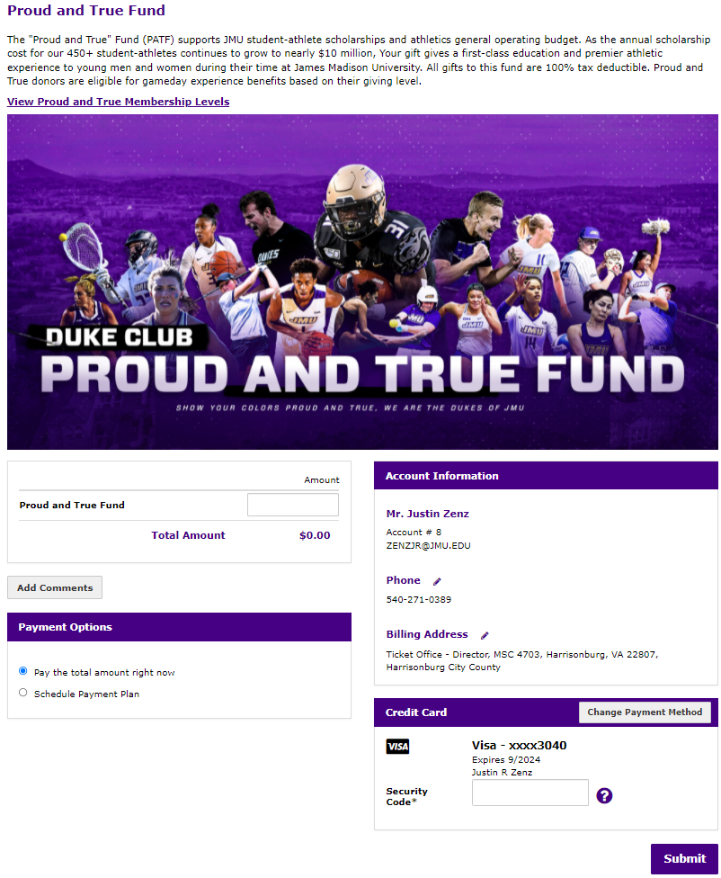
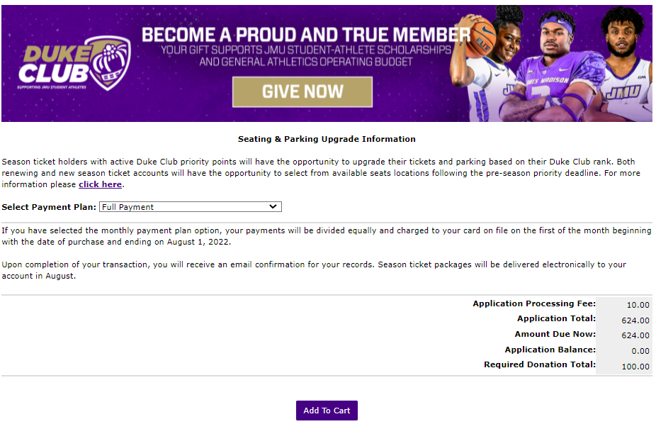
Our Online Renewal Form – the Donation Ask

Slide 22
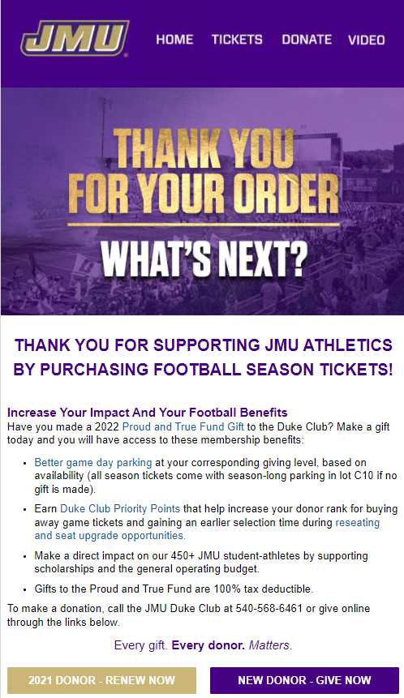
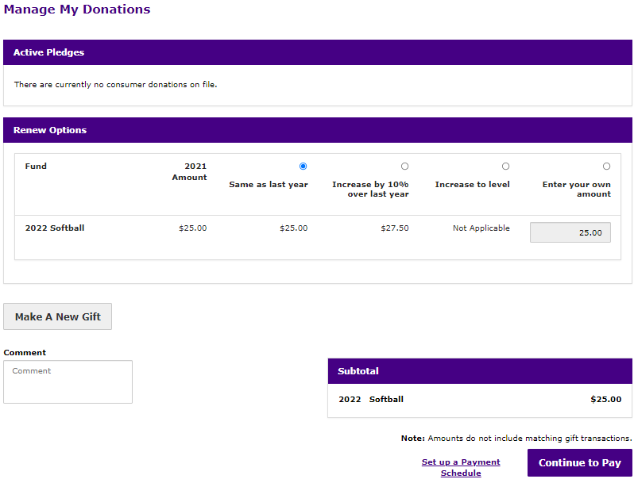
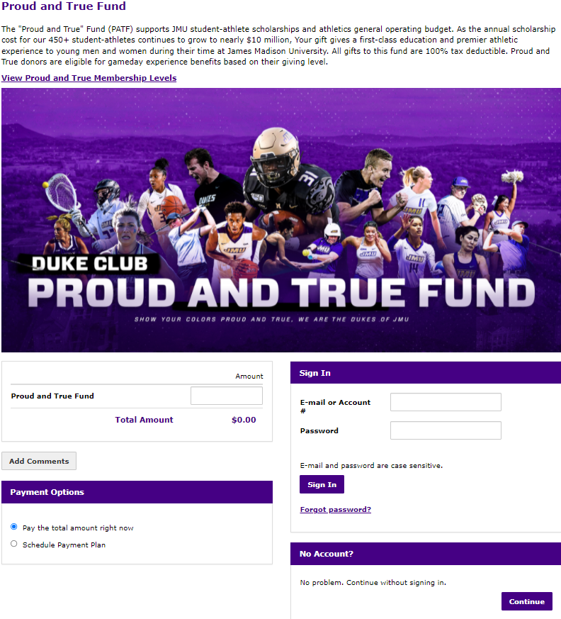
Thank you for renewing – post renewal campaigns

Slide 23
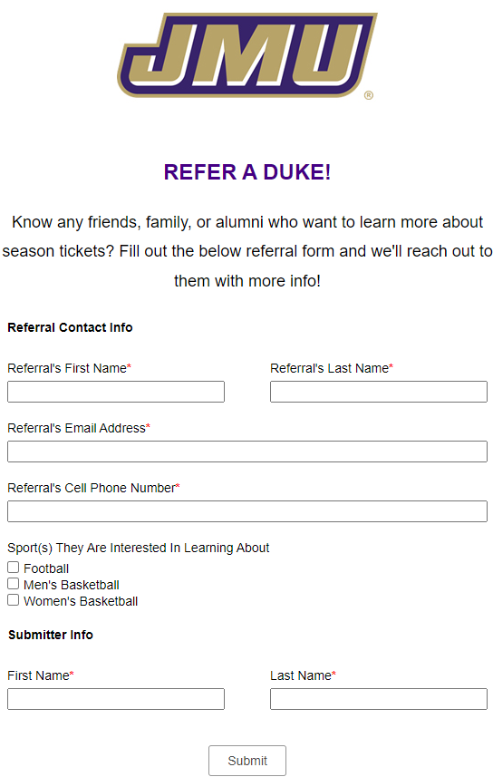
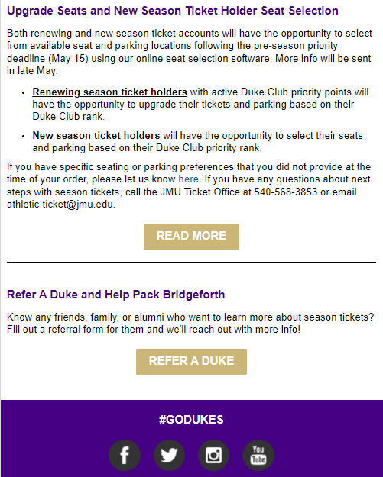
Thank you for renewing – post renewal campaigns

Slide 24
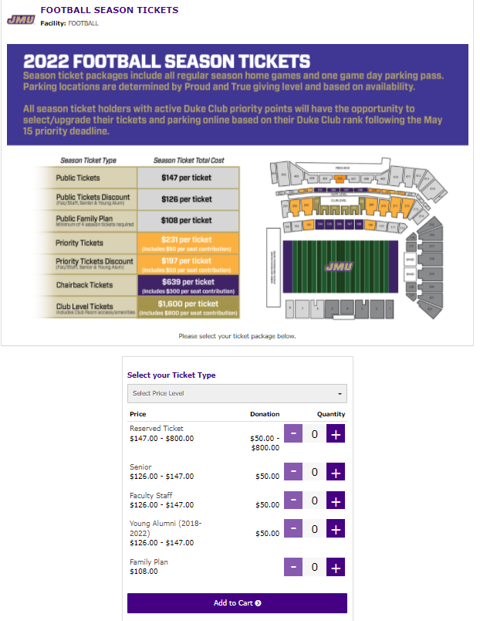
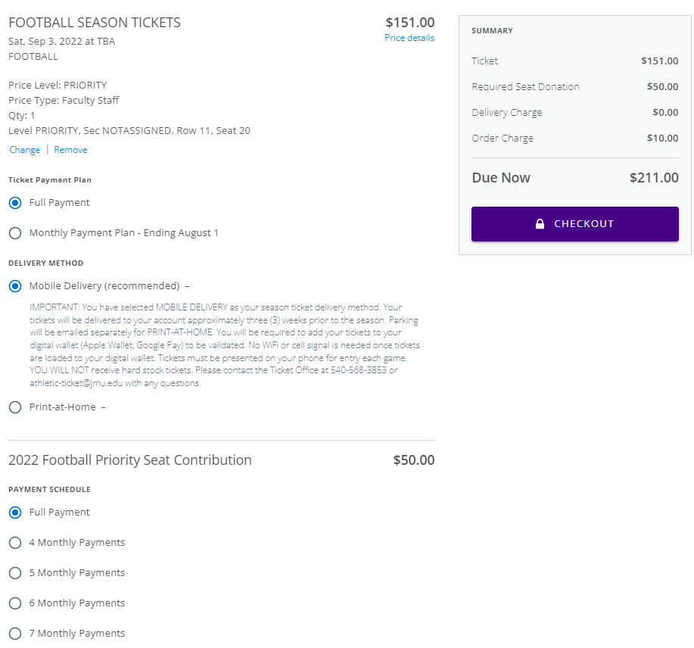
New Season Ticket Sales
More info is better – include your Season Ticket & Per Seat Contribution chart in purchase process
RSD allows flexible payments plans for tickets vs. donations

Slide 25
Summary & Recommendations
RSD is effective at collecting the per seat donation at time of purchase
RSD works and does the job, but there are some limitations – consult with your EOS and CP
Recommendation: look at other opportunities for additional donation asks throughout the process
Recommendation: fan education & communication is key throughout the process

Slide 26
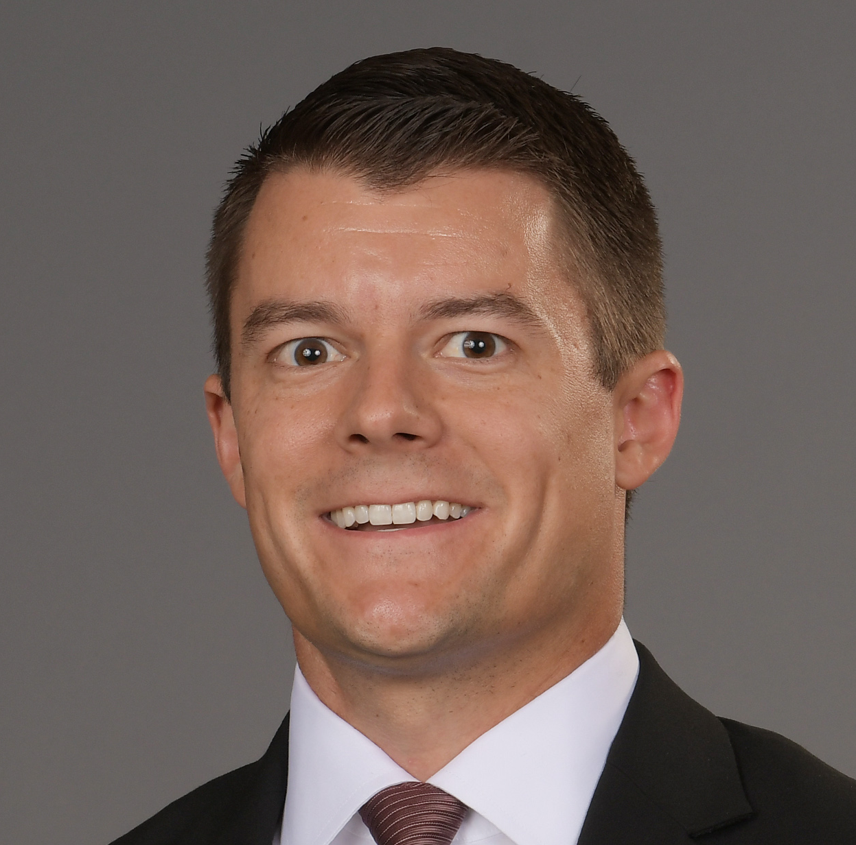
Grant Duncan
Virginia Tech

Slide 27

Organizational Shift
Evolution of External Ops
Integrated business model / All revenue buckets under one umbrella
Everyone is Responsible for Revenue → Digital strategy, brand advancement, in-venue, communications, ticket sales, fundraising, and content strategy
Every Dollar is the Same
One Brand Mindset – Accounts are transacting with Virgnia Tech

Slide 28



Initial Projects
COVID Year --> Keeping Revenue in the Door
Virtual 5K
Fan Cutouts
Subscription Boxes
Merchandising/Give to Get Campaigns

Slide 29
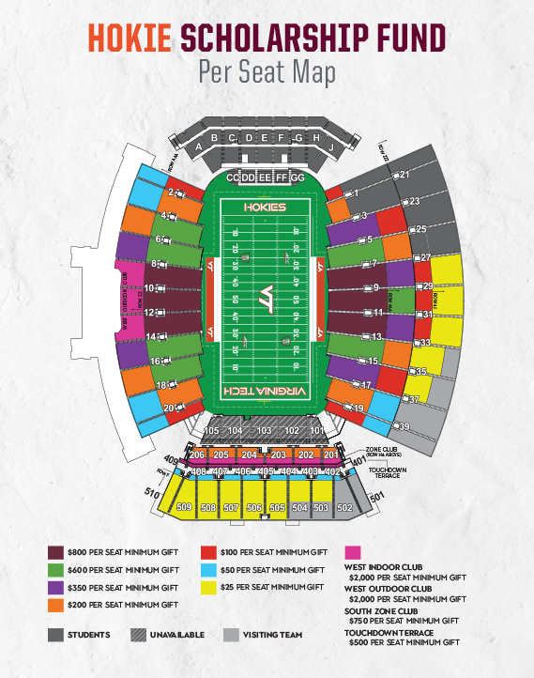
Year 1 - RSD
Program Overview
Every seat requires a per seat donation, starting at $25/seat
Membership levels determine:
  Parking location
  Additional tickets in priority
Ticket deadline separate from giving deadline

Slide 30
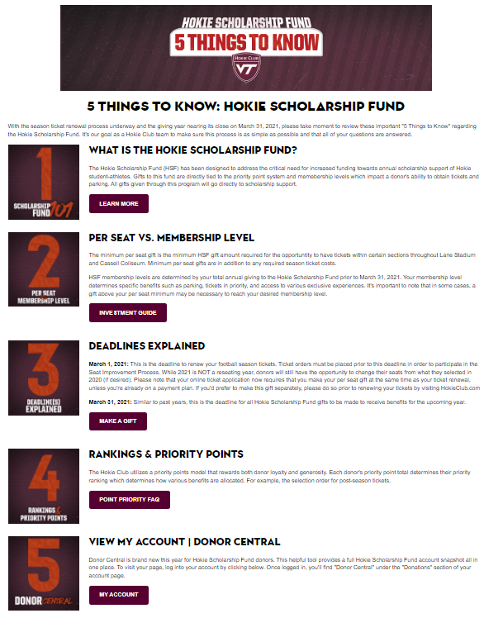
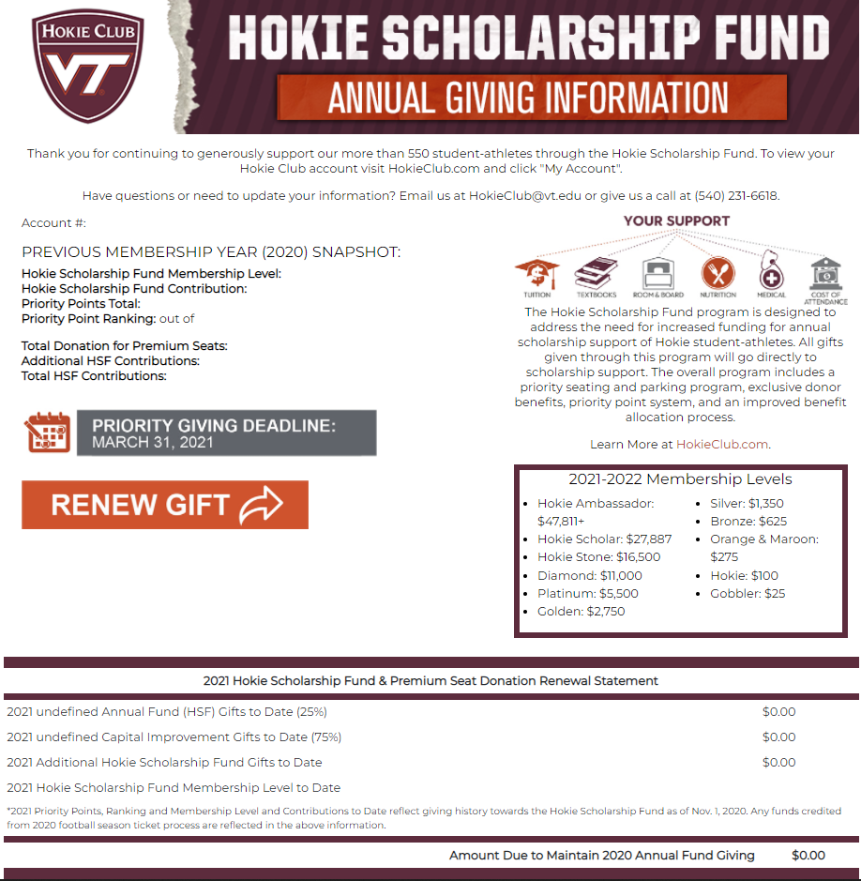
Year 1 - RSD
Communication
  Pre-Launch Email(s)
  5 Things to Know
  Frequently Asked Questions
Collecting the over and above gift(s)
  Digital statement
  SalesForce Opps

Slide 31
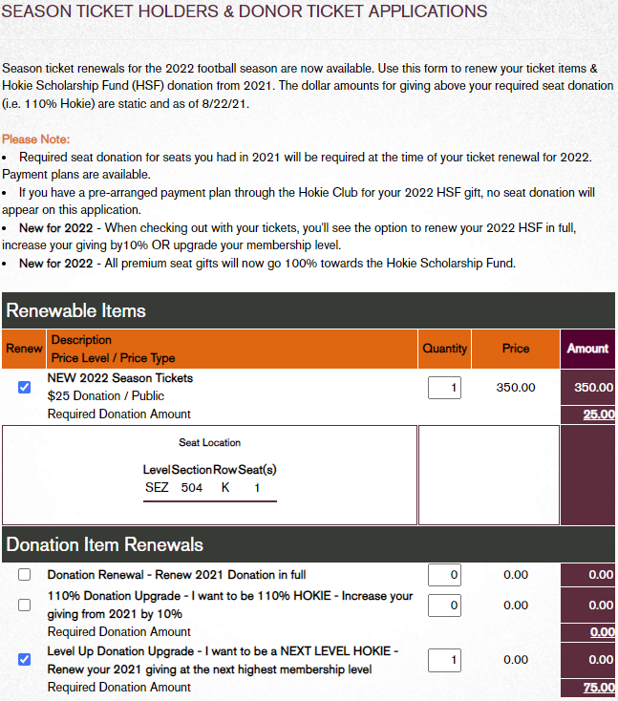
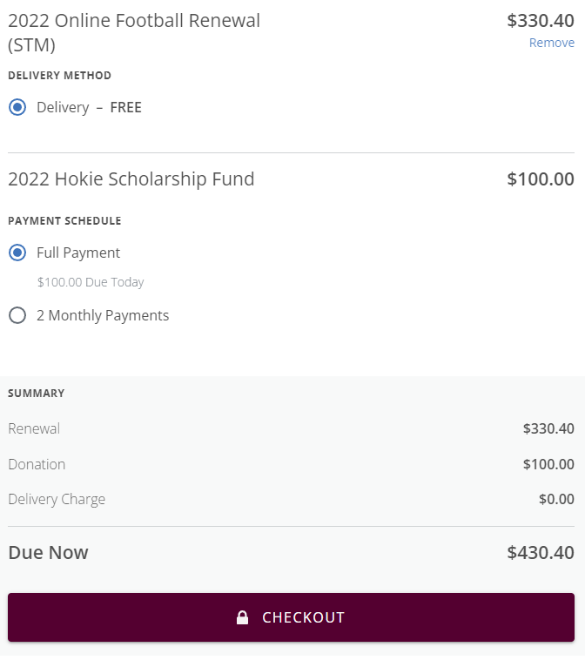
Year 2
One Stop Shop
Ticket Renewal Includes:
  Football Season Tickets
  Chairbacks
  Parking
  Required Seat Donation
  3 Optional Giving Amounts
    Renew Giving in Full
    110%
    Upgrade Membership Level
Separate payment plans for giving/ticketing

Slide 32
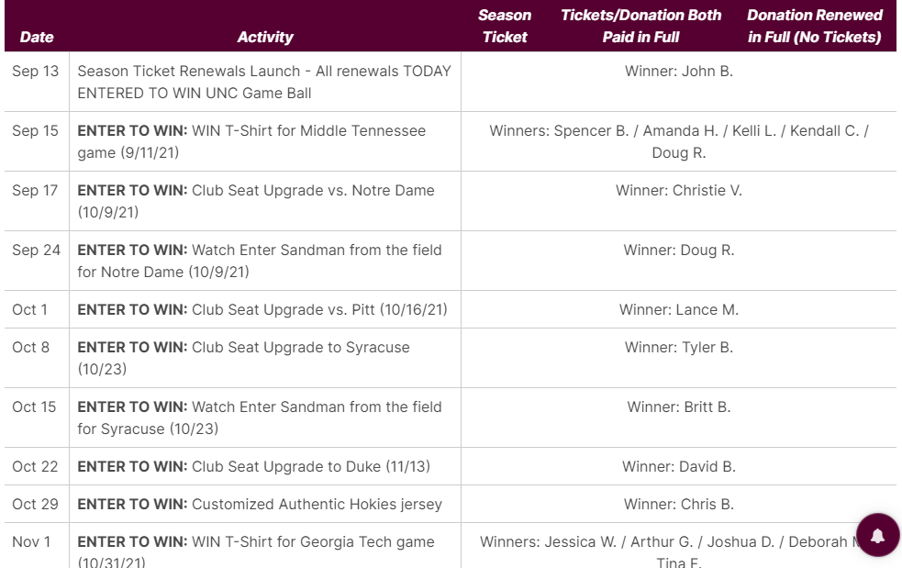
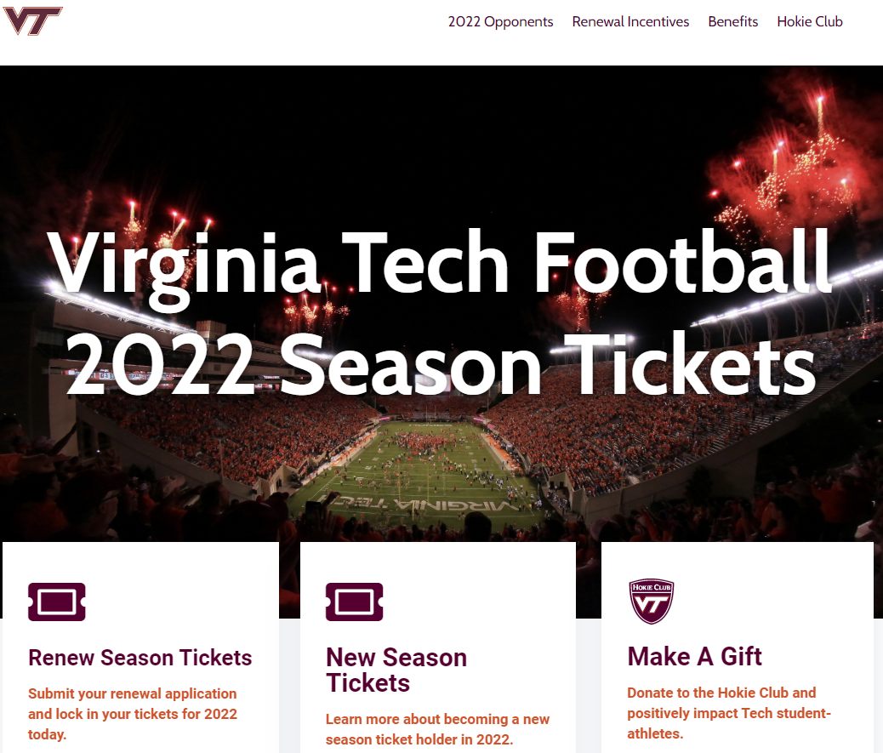
Creating A Joint Customer Experience
Early renewal incentives for all
Coordinated communication efforts through Digital Strategy team
Account Management Program
  Every gift officer has an assigned ticket account rep

Slide 33
Reporting & Results
81% Renewed To Date - Checked out w/ at least their RSD
1,787 accounts checked out with an additional gift (37%)
  1,435 – Full giving renewal
  228 – Renewal at 110%
  124 – Membership level upgrade
Current Seating Fund Revenue To Date (2022): $13.48M
  2021 Seating Fund Rev. To Date: ~$11M

Slide 34
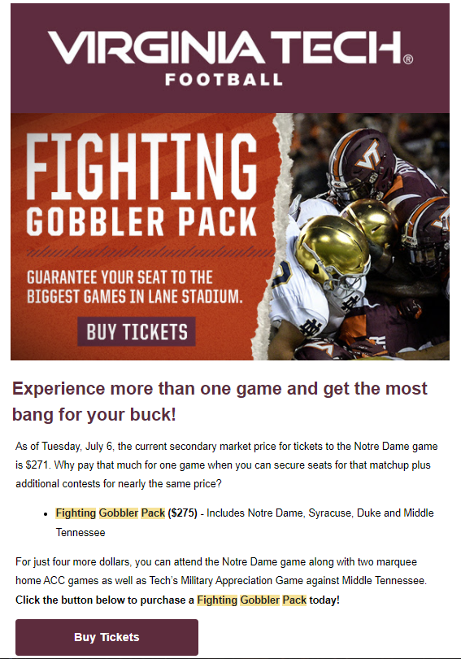
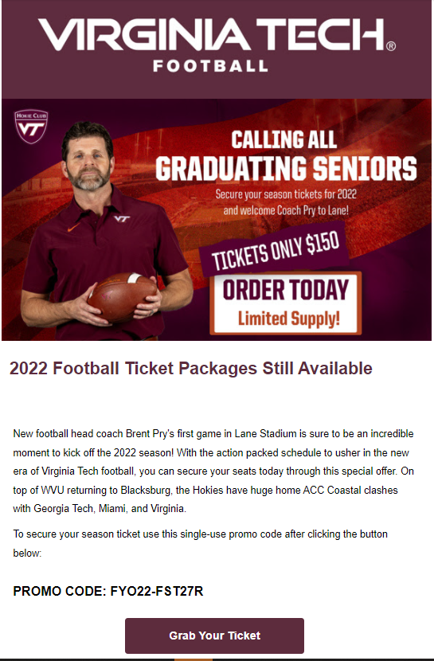
Lessons Learned
& Additional Opportunities
Leverage RSD on non-season ticket items
  Fighting Gobbler Pass
    4 games
    $300 inclusive of $25 gift
    285 accounts purchased//made gift
    259 were new or recouped donors
Apply RSD to student season tickets --> Student Hokie Club Membership
  Increase membership from 3k to 11k
First Year Out Season Ticket + Gift
  178 tickets sold

Slide 35

Lessons Learned & Additional Opportunities
Account Management Program
Transition to one phone line
Understanding the value of new accounts --> Continuing to grow funnel for tickets/giving
  Calendar Year '21: 53,655 new accounts created
  Responsible for just over $4M in revenue
    $69 average ticket spend
    $7 average donation per account

Slide 36
What's Next
Segmentation mapping
All-in-One Renewal
  Giving + tickets for all relevant sports
  Merging solicitations to one ask (i.e. renewal statement)
  Combined seat improvement/selection process for all sports
  Joint Deadlines – March 1
Emphasis on: Payment plans / Recurring giving
Exploring: Auto-renew / Multi-year renewals

Slide 37
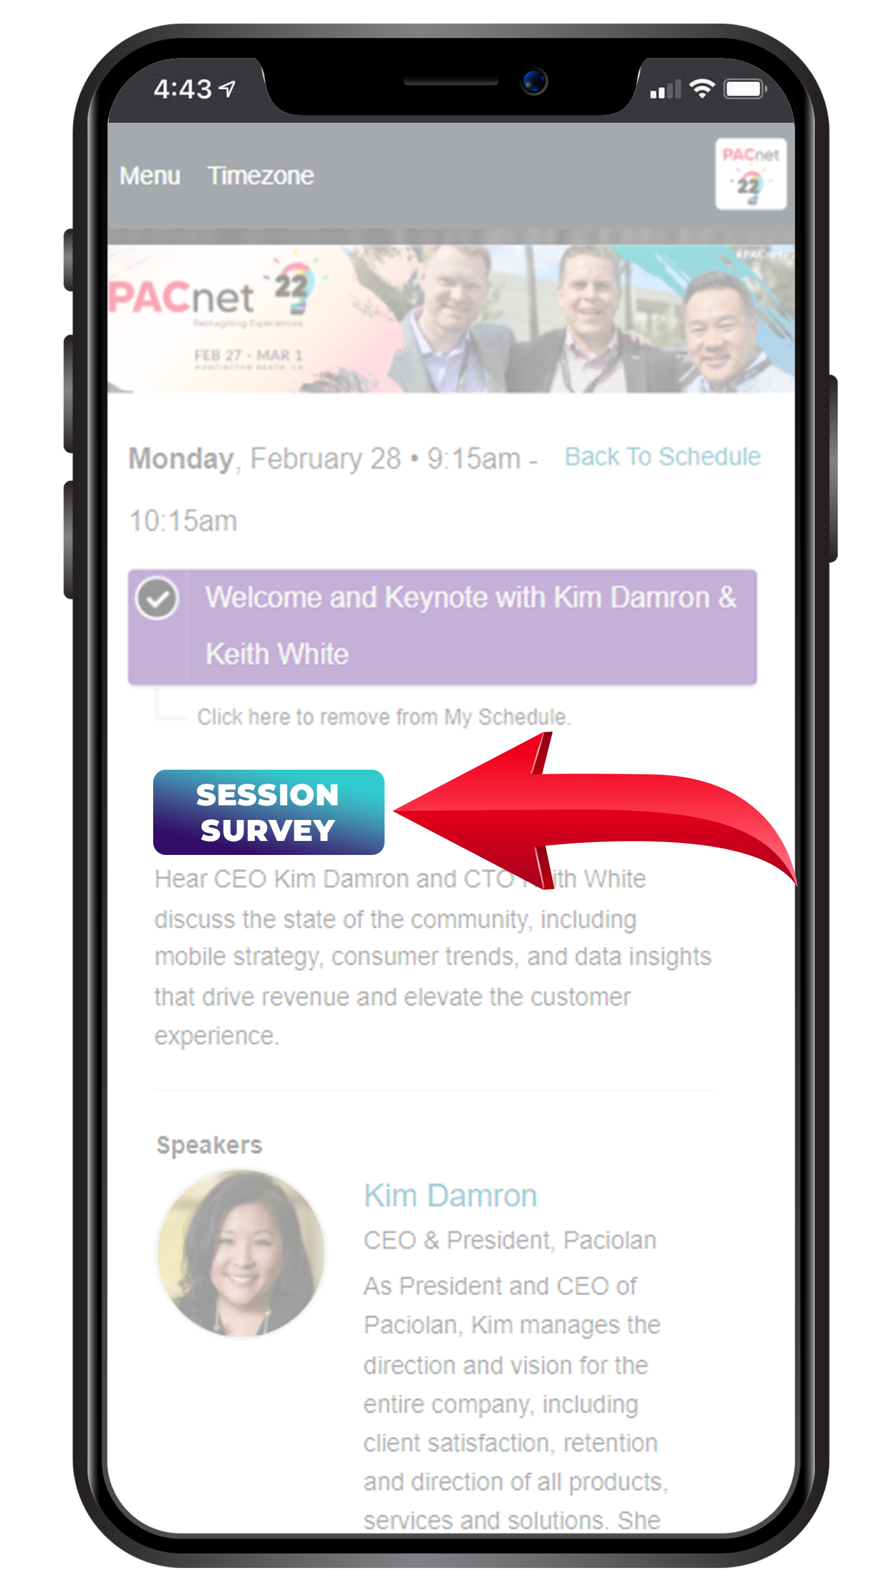
THANK YOU!
QUESTIONS?
Please complete the online session evaluation.

